Slide 1
Chapter 3: Reliability and Its Importance

Slide 2
Introduction (1 of 2)
Reliability: amount of randomness in a set of scores.
Randomness in real life.
High consistency and low randomness.
Notes:
Reliability: It refers to how much randomness there is in a bunch of the scores.
Randomness in real life:
There are random variables bouncing against us when we take a quiz or respond to an attitude survey that affect how we respond.
When guessing an answer on a test, sometimes we guess right and sometimes we guess wrong, and that’s what is called random.
Good test developers want their scores to not be random, but they want their measures to be reliable.
High consistency and low randomness:
Reliability concerns the consistency of scores if people took the same test twice.
For instance, personality traits are believed to be fairly stable over a long period of time.
If a test of introversion is administered to a group of people, their scores will vary because people have different levels of introversion.
So, while some of that variability is true, some is only due to randomness.
If the test is highly consistent, then it means that the test has low randomness.
People check for randomness in the variability of scores, by comparing the pairs of scores obtained from the same test.

Slide 3
Introduction (2 of 2)
Quantifying reliability.
Ways to get two scores from the same test:
  Test-retest reliability.
  Inter-rater reliability.
Notes:
Quantifying reliability: To quantify reliability or to “put a number on it,” researchers and test developers find ways to obtain a pair of scores for individuals from the same test.
Ways to get two scores from the same test:
Test-retest reliability: Here, a test is given to a bunch of people and the same test is given to them later; the two scores are compared to examine consistency.
Inter-rater reliability: Here, two people or “raters” score the same person and compare their two scores to examine their consistency.

Slide 4
Test Scores (1 of 3)
Different elements of a test score:
  Observed score.
  True score.
  Error score.
Using test-retest designs to examine reliability.
Notes:
Different elements of a test score:
Observed score: the score a person actually gets on the test.
True score: a theoretical score that represents an individual’s typical level of performance; the average score a person would get if they took the same test an infinite number of times.
Error score: how big a gap there is between the observed score and true score.
Using test-retest designs to examine reliability:
Using test-retest designs, we estimate true scores, and, by guessing at the true score and knowing the observed score, we can calculate the error score.
Smaller error score means that the measure is more reliable.

Slide 5
Test Scores
True score and observed scores are not always equal.
Randomness in measurement is unavoidable.
Notes:
True score and observed scores are not always equal:
This is because of the randomness in test scores.
Humans, aren’t perfect and aren’t consistent which makes it almost impossible to predict what they are going to do.
It is impossible to tell the exact score a person will get on a test, even if it’s the second time the person took the test.
Randomness in measurement is unavoidable:
Randomness in measurement is a fact of life.
What is seen as an observed score may come close to the true score, but rarely are they the same.
The difference is in the amount of error that is introduced.

Slide 6
Test Scores (3 of 3)
Error: difference between observed score and true score
The sources of error.
True score does not deal with the construct of interest.
Reliability in terms of precision.
Notes:
Error: the difference between one’s observed score and one’s theoretical true score.
The sources of error:
It might be because the room in which the test is taken is so warm that it’s easy for the student to fall asleep.
Or, it might be because the student didn’t study for the test or, even the student isn’t in the mood that day to undertake a test.
All these sources of error can contribute to the unreliability of an instrument, because they mask the true performance or true score.
True score does not deal with the construct of interest:
True score represents the theoretical typical level of performance on a given test and it does not have anything to do with whether the construct of interest is being reflected.
A reliable test consistently produces a score a person would get on average, regardless of what the test is measuring.
Even, a perfectly reliable test might not produce a score that has anything to do with the construct of interest.
Reliability in terms of precision:
Precision refers to how accurate the testing process is in its intent to hit the target.
The more precise a test is, the more reliable it is.

Slide 7
Getting Conceptual (1 of 3)
Observed score = True score + Error score.
Classical Test Theory.
Types of error: trait error and method error.
Observed score = True score + (Trait error score + Method error score).
Notes:
Getting Conceptual
Equation for calculating the observed score:
Observed score = True score + Error score.
The score that is observed is composed of an individual’s true score and an error score
.
Classical Test Theory: a theory based on the equation of observed score.
Types of error:
Trait error: error due to differences in the individual taking the test.
Method error: error due to differences in test administration
By expanding the earlier simple equation, we get this equation: Observed score = True score + (Trait error score + Method error score).

Slide 8
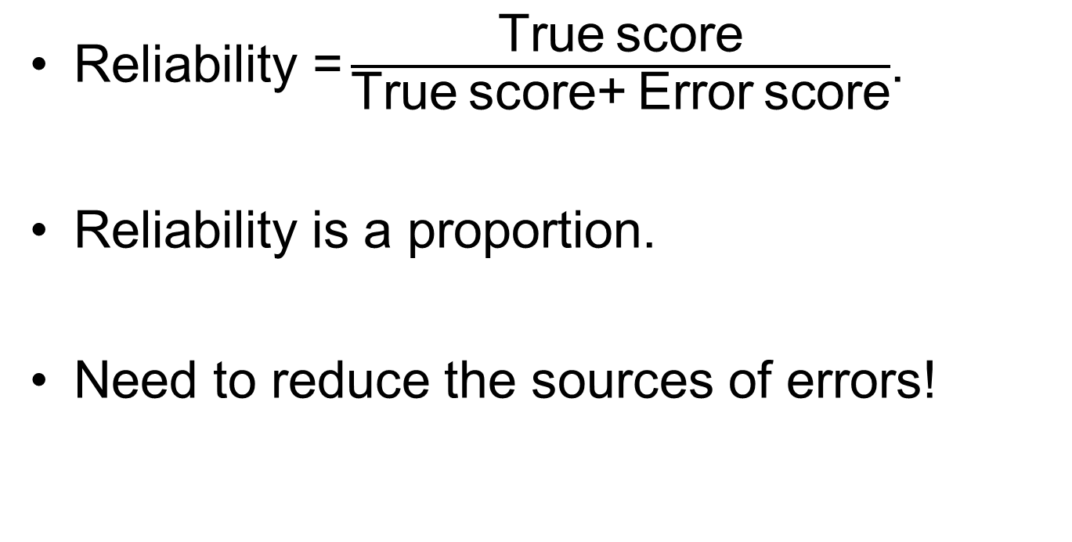
Getting Conceptual (2 of 3)
$\text{Reliability} \text{=}\frac{\text{True} \text{score}}{\text{True} \text{score}\text{+ }\text{Error} \text{score}}$.
Reliability is a proportion.
Need to reduce the sources of errors!
Notes:
Classical Test Theory takes the basic equation and defines reliability using a final equation:
$\text{Reliability}\text{=}\frac{\text{True} \text{score}}{\text{True} \text{score}\text{+ }\text{Error} \text{score}}$.
Reliability is a proportion:
If the error score gets smaller, then the reliability value gets larger.
If there is no error score, then the reliability is perfect as it is equal to an individual’s true score.
Need to reduce the sources of errors:
To increase reliability, we must reduce the sources of errors as much as possible so that the observed score more closely matches the true score.
Scores on repeated testings tend to vary and reliability allows us to understand which proportion of the variation in test scores is due to actual changes in performance or behavior and which is due to error variance.
Reducing the error variance makes a test more reliable.

Slide 9
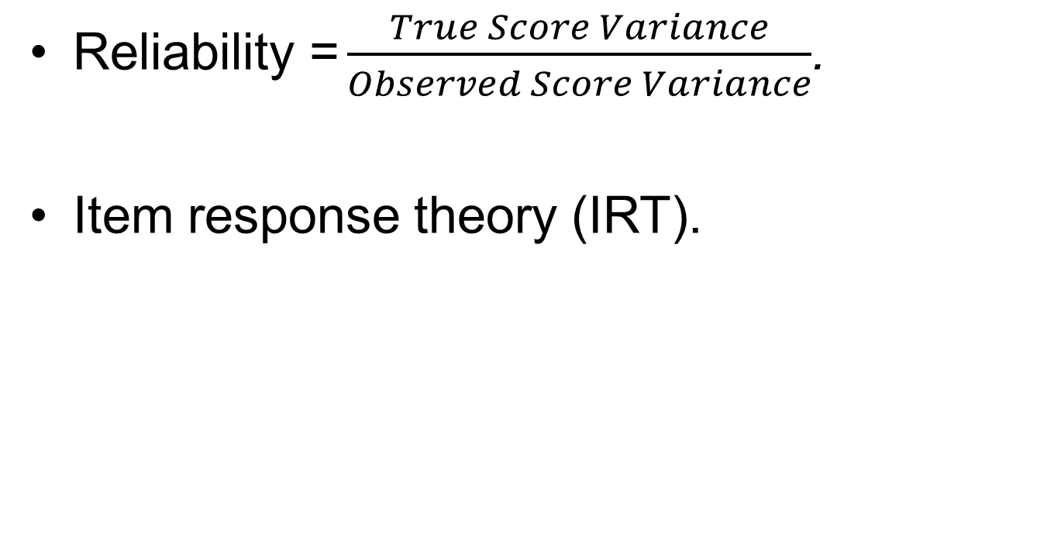
Getting Conceptual (3 of 3)
$\text{Reliability} \text{=}\frac{True Score Variance}{Observed Score Variance}$.
Item response theory (IRT).
Notes:
Another definition of reliability:
Reliability refers to the proportion of the variance in a set of observed scores that is true score variance.
This is expressed as follows: $\text{Reliability} \text{=}\frac{True Score Variance}{Observed Score Variance}$.
Item response theory (IRT):
It is based on the idea that the likelihood of a correct response is a function of the person taking the test and the characteristics of the items.
It is also known as latent trait theory, because traits of an individual play a key role in performance.

Slide 10
Putting a Number on Reliability
(1 of 2)
Correlation between two sets of scores.
Correlation coefficient: reflects relationship between two variables.
Reliability coefficient vs. correlation coefficient.
Notes:
Correlation between two sets of scores:
Reliability reflects the consistency of test scores when the test is taken twice.
Consistency can be though of as having a correlation between two sets of scores.
The correlation coefficient is a very common statistic to reflect the correlation between two sets of scores.
Reliability is often quantified through the computation of a correlation coefficient.
Correlation coefficient:
A numerical index that reflects the relationship between two variables.
For reliability purposes, correlation coefficients tend to range between .00 and +1.00.
The higher the number, the more reliable the test.
Reliability coefficient vs. correlation coefficient:
Reliability coefficient is another form of correlation coefficient that ranges from .00 to +1.00, while correlation coefficients can range from –1.00 to +1.00.
This discrepancy is because of the fact that no test can have a modicum of reliability with a coefficient less than .00.
Reliability coefficients are worth considering only when they are positive.

Slide 11
Putting a Number on Reliability (2 of 2)
Scores of 15 adults on a 10-item achievement test at two different times.
ID | September Testing | October Testing
1 | 78 | 79
2 | 65 | 78
3 | 65 | 66
4 | 78 | 80
5 | 89 | 78
6 | 99 | 94
7 | 93 | 95
8 | 75 | 78
9 | 69 | 72
10 | 87 | 82
11 | 45 | 49
12 | 66 | 68
13 | 87 | 81
14 | 85 | 87
15 | 78 | 69
Notes:
This table shows set of two scores on a 10-item achievement test that is given to 15 adults in September and given again 30 days later in October to the same 15 adults.
Each adult has two scores.
If this test is reliable, these two sets of scores will be very similar, and that there will be a high correlation between them.
Here, the correlation between the score from testing in September and the score from testing in October is .90.
As this value is certainly, we conclude that this test is reliable.

Slide 12
Different Flavors of Reliability (1 of 16)
Test–Retest Reliability
Used to know whether a test is reliable over time.
Time sampling.
Need to be confidence about getting reliable measure.
Notes:
Test–Retest Reliability
This kind of reliability is used when we want to examine whether a test is reliable over time. It is also known as stability.
Time sampling: It is when the samples of scores are taken at more than one point in time.
Need to be confidence about getting reliable measure:
Test–retest reliability is often calculated and reported when researchers are examining differences or changes over time or after an intervention.
One must be very confident that what they are measuring is being measured in a reliable way such that the results come as close as possible to the individual’s true score each and every time.

Slide 13
Different Flavors of Reliability (2 of 16)
ID | Score From Test 1 (Time1) | Score From Test 2 (Time2)
1 | 54 | 56
2 | 67 | 77
3 | 67 | 87
4 | 83 | 89
5 | 87 | 89
6 | 89 | 90
7 | 84 | 87
8 | 90 | 92
9 | 98 | 99
10 | 65 | 76
Notes:
.
Test–Retest Reliability
Using the scores given in the table, we can compute the Pearson correlation coefficient as a measure of the test–retest reliability of the instrument.
To estimate reliability, we compute the Pearson product-moment correlation, which is equal to: r_{Time1⋅Time2} = .89, where, r is the correlation and the subscript to the r indicates the reliability of a test using scores from both Test 1 and Test 2.

Slide 14
Different Flavors of Reliability (3 of 16)
The Problem with Test–Retest Reliability
The risk of practice effects.
Interaction between the amount of time between tests and the nature of sample.
Notes:
The Problem with Test–Retest Reliability
The risk of practice effects: The risk of practice or carryover effects occurs when the first testing influences the second.
Interaction between the amount of time between tests and the nature of sample:
For instance, when assessing some aspect of growth and development in young children, waiting 3 or 6 months to retest motor skills might result in an inaccurate correlation.
This is because dramatic changes in behavior occur at that age over that period of time and such changes may not occur in a systematic fashion in the entire group of children.

Slide 15
Different Flavors of Reliability (4 of 16)
Inter-Rater Reliability
Examines how much two scorers might agree on their judgments of outcome.
Importance of the degree of randomness.
Notes:
Inter-rater Reliability
It examines how much two different scorers might agree on their judgments of some outcome.
Importance of the degree of randomness: The degree of randomness in the scoring of the observations is important for when we do analysis for our research, so we build in an inter-rater reliability study as part of the project.

Slide 16
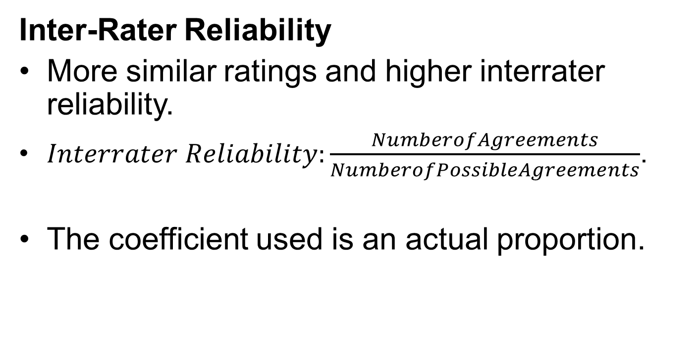
Different Flavors of Reliability (5 of 16)
Inter-Rater Reliability
More similar ratings and higher interrater reliability.
$Interrater Reliability:\frac{NumberofAgreements}{NumberofPossibleAgreements}$.
The coefficient used is an actual proportion.
Notes:
More similar ratings and higher interrater reliability:
To ensure that what we are recording is reliable, we must find out the level of agreement between different observers.
The more similar the ratings are, the higher the level of interrater agreement and interrater reliability.
Formula for computing interrater reliability: $InterraterReliability=\frac{NumberofAgreements}{NumberofPossibleAgreements}$.
In the case of inter-rater reliability, the coefficient used is an actual proportion, and this is not the case with the correlations used to describe other types of reliability.

Slide 17
Different Flavors of Reliability (6 of 16)
Inter-Rater Reliability
Time | Period → | 1 | 2 | 3 | 4 | 5 | 6 | 7 | 8 | 9 | 10 | 11 | 12
Rater 1 | You | / | — | / | / | / | — | / | / | — | — | / | /
Rater 2 | Friend | / | — | / | / | / | — | / | / | — | / | — | /
Notes:
Table: Data for examining a particular type of social interaction during a transaction between a banker and a customer.
Here, two raters have noted every 10 seconds if the banker is demonstrating one of the three different behaviors: smiling, leaning forward in her chair, or using her hands to make a point.
The slashes in the table indicate the presence of one of the three customer-friendly acts and the dashes indicate the absence of any such acts.
The important variable is whether or not any one of the three acts occurred within a set of 10-second time frames across 2 minutes.
For a total of 12 periods, there are 7 where both raters agreed that the banker did do the customer-friendly thing, and 3 where they agreed the banker did not, for a total of 10 agreements and 2 disagreements.
We compute interrater reliability as follows:$\text{Interrater} \text{reliability} =\frac{\text{10}}{\text{12}}=\text{.833}\text{.}$
The resulting interrater reliability coefficient is .83 which means that the two raters agreed 83% of the time.

Slide 18
Different Flavors of Reliability (7 of 16)
Parallel Forms Reliability
Examines equivalence or similarity between two forms of a test.
Item sampling.
Use of different forms of standardized tests.
Notes:
It examines the equivalence or similarity between two different forms of the same test
Item sampling: the samples of scores are taken using different sets of items.
Use of different forms of standardized tests:
Large commercial test development companies that make standardized tests, like the ACT and the SAT, use different forms all the time.
The ACT taken by a person in New York is not the same as the one taken by a person in California.
So it is clear that the ACT company has established parallel forms reliability for all their different test forms.

Slide 19
Different Flavors of Reliability (8 of 16)
Parallel Forms Reliability
Table: Scores from the Remember Everything Test (RET) in two forms.
ID | Scores From Form A of the RET | Scores From Form B of the RET
1 | 4 | 5
2 | 5 | 6
3 | 3 | 5
4 | 6 | 6
5 | 7 | 7
6 | 5 | 6
7 | 6 | 7
8 | 4 | 8
9 | 3 | 7
10 | 3 | 7
Notes:
Parallel Forms Reliability
In this example, the same ideas are being tested using a different form.
Our goal is to compute a correlation coefficient as an estimate of the parallel forms reliability of the instrument
To do this, we compute the Pearson product-moment correlation. In this example, it is equal to r_{FormA⋅FormB} = .12.

Slide 20
Different Flavors of Reliability (9 of 16)
Internal Consistency Reliability
Used to know whether the items on a test are consistent.
Situation when evidence of internal reliability is necessary.
Notes:
Internal Consistency Reliability
It is used when we want to know whether the items on a test are consistent with one another and likely measure the same thing.
Situation when evidence of internal reliability is necessary: It is needed when we want to measure a variable or construct by asking a bunch of questions and combining the answers together.

Slide 21
Different Flavors of Reliability (10 of 16)
Internal Consistency Reliability: Split-Half Reliability
Split-half reliability coefficient:
  Classic way to establish internal consistency.
  Involves splitting the test into two halves.
  Scores on the two halves are compared to determine the relationship between the two.
Notes:
Split-Half Reliability
Split-half reliability coefficient:
It is the classic way to establish internal consistency of a test.
It involves “splitting” the test into two halves.
The scores on one half of the test are compared with scores on the second half of the test to see if there is a strong relationship between the two, and if so, then the test has internal consistency.

Slide 22
Different Flavors of Reliability (11 of 16)
Drawbacks of first half–second half method:
  Items are less likely to be equal to each other.
  Some people might not reach the later items and scorer 0’s for those items.
Notes:
Split-Half Reliability
Drawbacks of first half–second half method:
It’s easier to do the first half–second half method, but is risky because, if items tend to be grouped by subject matter or by difficulty, it is less likely that the groups of items will be deemed equal to each other.
And if a test is tiring to take, some people might not even get to the later items and scorer 0’s for those items regardless of their level of knowledge.

Slide 23
Different Flavors of Reliability (12 of 16)
Best way to split a test:
  Selecting the odd items for one grouping and the evens for another.
Computing split-half reliability coefficient as an indicator of internal reliability.
Notes:
Internal Consistency Reliability
Split-Half Reliability
Best way to split a test: selecting all the odd items for one grouping and all the evens for another, and then computing the correlation coefficient.
Computing split-half reliability coefficient as an indicator of internal reliability: To do this, we correlate the score of each person on the odd half of their test with the score on the even half.

Slide 24
Different Flavors of Reliability (13 of 16)
The issue of computing split-half reliabilities.
Notes:
King Solomon Might Have Been Off by Half, or Correct Me If I Am Wrong
The issue of computing split-half reliabilities: The test is cut into half, and shorter tests are less reliable, the real degree of reliability is constrained.

Slide 25
Different Flavors of Reliability (14 of 16)
Cronbach’s Alpha (or α)
A measure of internal consistency.
Used to evaluate the reliability of test with or without right/wrong answers.
Notes:
3.4. Differentiate between four types of reliability.
Cronbach’s Alpha (or α)
Cronbach’s alpha or coefficient alpha: a measure of internal consistency.
Used to evaluate the reliability of test with or without right/wrong answers:
Cronbach’s alpha is especially used to evaluate reliability of a test with no right or wrong answers.
However, it can also be used to evaluate the reliability of tests with right/wrong answers as well.

Slide 26
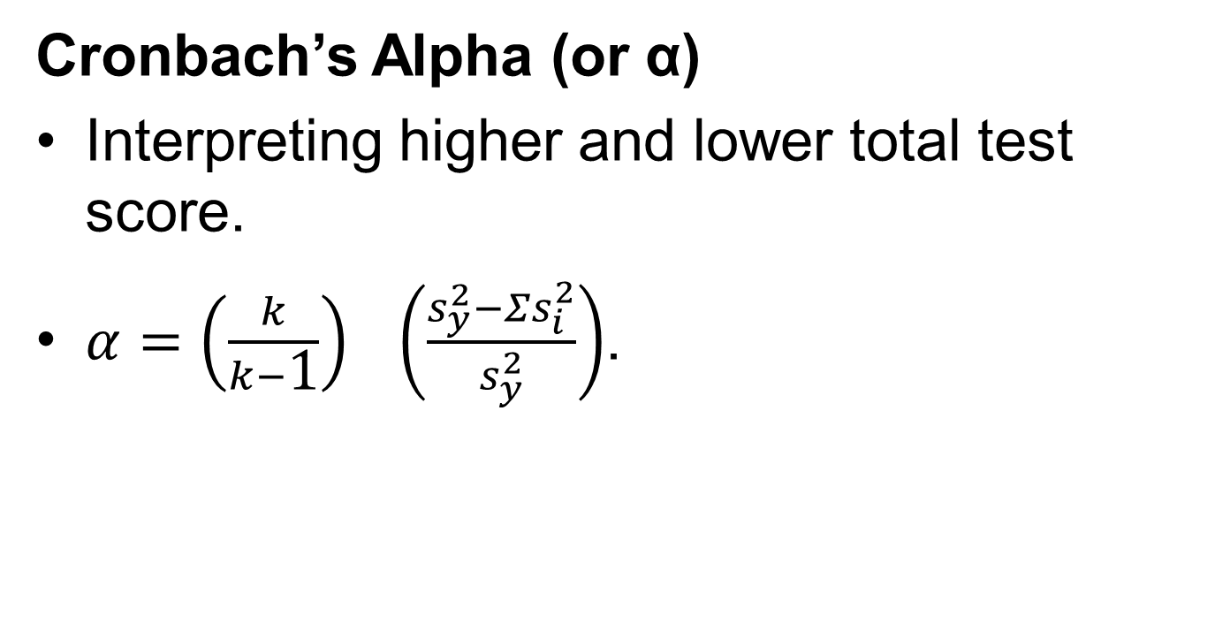
Different Flavors of Reliability (15 of 16)
Cronbach’s Alpha (or α)
Interpreting higher and lower total test score.
$α=\left(\frac{k}{k−\text{1}}\right) \left(\frac{s_{y}^{2}−Σs_{i}^{2}}{s_{y}^{2}}\right)$.
Notes:
3.4. Differentiate between four types of reliability.
Cronbach’s Alpha (or α)
Interpreting higher and lower total test score:
We compute Cronbach’s alpha by correlating the score for each item with the total score for each individual and then comparing that with the variability present for all individual item scores.
Any individual test taker with a high(er) total test score should have a high(er) score on each item for a total score.
Similarly, any individual test taker with a low(er) total test score should have a low(er) score on each individual item for a total score.
Formula to compute Cronbach’s alpha: $α=\left(\frac{k}{k−\text{1}}\right) \left(\frac{s_{y}^{2}−Σs_{i}^{2}}{s_{y}^{2}}\right)$, where:
k = the number of items.
$s_{y}^{2}$ = the variance associated with the observed score.
$Σs_{i}^{2}$ = the sum of all the variances for each item.

Slide 27
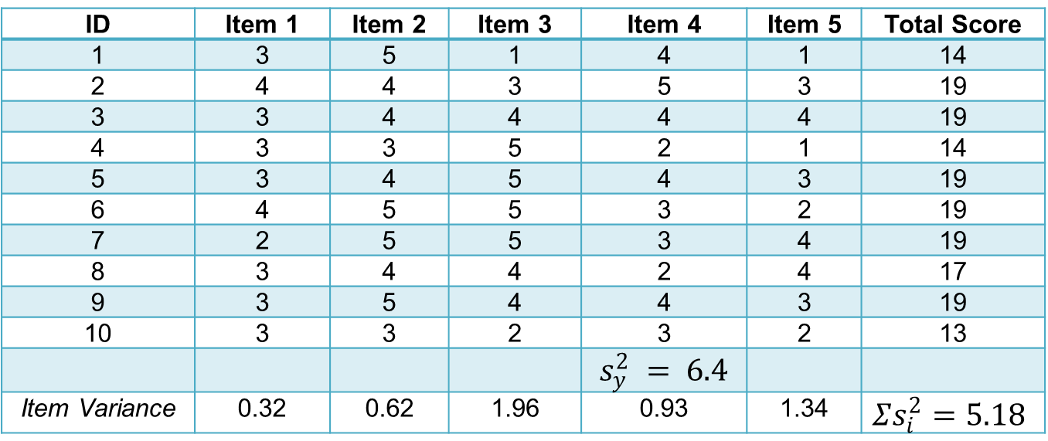
Different Flavors of Reliability (16 of 16)
Cronbach’s Alpha (or α)
Table: Sample data for 10 people on a five-item attitude test.
ID | Item 1 | Item 2 | Item 3 | Item 4 | Item 5 | Total Score
1 | 3 | 5 | 1 | 4 | 1 | 14
2 | 4 | 4 | 3 | 5 | 3 | 19
3 | 3 | 4 | 4 | 4 | 4 | 19
4 | 3 | 3 | 5 | 2 | 1 | 14
5 | 3 | 4 | 5 | 4 | 3 | 19
6 | 4 | 5 | 5 | 3 | 2 | 19
7 | 2 | 5 | 5 | 3 | 4 | 19
8 | 3 | 4 | 4 | 2 | 4 | 17
9 | 3 | 5 | 4 | 4 | 3 | 19
10 | 3 | 3 | 2 | 3 | 2 | 13
 |  |  |  | $$s_{y}^{2} = 6.4$$
Item Variance | 0.32 | 0.62 | 1.96 | 0.93 | 1.34 | $$Σs_{i}^{2}=5.18$$
Notes:
Table: Sample data for 10 people on a five-item attitude test.
Cronbach’s Alpha (or α)
This table lists some sample data for 10 people on a five-item attitude test, where scores are between 1 (strongly disagree) and 5 (strongly agree) on each item.
This format is called a Likert-type format.
When we plug all these figures into the equation to compute Cronbach’s alpha, we get $α=\left(\frac{5}{5−\text{1}}\right) \left(\frac{6.40−5.18}{6.4}\right)=.24$, where .24 is the coefficient alpha.

Slide 28
How Big is Big? Interpreting Reliability Coefficients
Reliability coefficients must be positive.
Reliability coefficients must be between +.00 and +1.00.
Acceptable values of reliability coefficients.
Notes:
The reliability coefficients must be positive.
The reliability coefficients must be as large as possible should be between +.00 and +1.00.
Acceptable values of reliability coefficients:
An acceptable reliability coefficient is .70 or above, but much more acceptable is .80 or above.
Except for very long standardized tests with lots of questions, it is rare to see values in the .90.
In inter-rater reliability, nothing less than 85% agreement should be expected.

Slide 29
And If You Can’t Establish Reliability . . . Then What? (1 of 3)
Points to consider to achieve reliability:
  Ensuring that instructions are standardized across all setting.
  Increase the number of items or observations.
  Delete unclear items.
Notes:
Points to consider to achieve reliability:
Make sure the instructions are standardized across all settings when the test is administered.
Increase the number of items or observations, because the larger the sample from the universe of behaviors, the more likely the sample is representative and reliable, and this is especially true for achievement tests.
Delete unclear items, because people will respond in one way on one occasion and in another way on a different occasion, regardless of their knowledge, ability level, or individual traits.

Slide 30
And If You Can’t Establish Reliability . . . Then What? (2 of 3)
  Don’t make too easy or too difficult questions.
  Minimize the effects of external events.
Notes:
Points to consider to achieve reliability:
For achievement tests especially, the questions should not be really hard or really easy, because any test that is too difficult or too easy does not reflect an accurate picture of one’s performance.
Minimize the effects of external events and standardize directions. If a particularly important event occurs near the time of testing, try to reschedule an assessment.

Slide 31
And If You Can’t Establish Reliability . . . Then What? (3 of 3)
Just One More Thing!
Establishing reliability is the first step to creating an instrument.
Random scores do not provide information.
Things to remember regarding reliability.
Notes:
Just One More Thing (and It’s a Big One)
The first step in creating or using an instrument with sound psychometric properties is to establish the reliability of that instrument.
Random scores do not provide information: If a test does not do the same thing over time, it can’t possibly be measuring what it is supposed to.
Things to remember regarding reliability:
Know whether or not the test is unreliable.
Understand what kind of reliability is important given the purpose of the test.
Learn how to increase the reliability if necessary.

